Slide 1

ANNAMACHARYA INSTITUTE OF TECHNOLOGY AND SCIENCES::TIRUPATI (AUTONOMOUS) Artificial Intelligence & Machine Learning A.Y.: 2025-2026 VIVA VOICE Predicting Digital Payment Platforms Adoption by Retail Vendors Using Machine Learning Techniques
Under the Guidance of
Mrs.S.Prathima., M.Tech
Assistant Professor
Department of AIML
AITS, Tirupati
Head of the Department
Dr C.Siva Balaji Yadav., Ph.D
Professor
Department of AIML
AITS, Tirupati
AIML-2- BATCH NO: 02
22AK1A3357 R POOJITHA
22AK1A3376 G SIDHARDHA
22AK1A3363 M PRUDUEESWAR
22AK1A3387 B VARUN

Slide 2
ABSTRACT
The adoption of digital payment platforms by retail vendors has become a pivotal transformation in India’s payment landscape. This project utilizes machine learning techniques to predict whether a retail vendor is likely to adopt digital payment systems such as Paytm, Google Pay, PhonePe, and Amazon Pay. Data was collected from merchants across major retail markets in Bangalore, targeting both organized and unorganized sectors. Through a comprehensive analytical approach involving descriptive statistics, exploratory factor analysis, and Support Vector Machine (SVM) modeling, the system identifies core factors influencing adoption: perceived usefulness, social influence, and compatibility. Additionally, the system evaluates customer satisfaction across platforms and forecasts future digital payment adoption trends using the ARIMA time series model. This integrated platform consists of three major modules: user (vendor interaction), admin (data management and analysis), and machine learning (prediction and forecasting). The system not only aids in understanding the behavior of retail vendors but also empowers policymakers, fintech providers, and entrepreneurs with actionable insights to improve the digital payments ecosystem.
Key Words
Support Vector Machine (SVM), ARIMA

Slide 3
DOMAIN INTRODUCTION
With the rise of fintech innovation and increasing smartphone penetration, digital payment platforms have revolutionized the way retail transactions are conducted in India. Vendors are progressively shifting from traditional cash-based models to convenient, secure, and efficient digital alternatives. However, despite this trend, a significant portion of small and medium-sized vendors remains reluctant or inconsistent in adopting these platforms. The decision to adopt digital payment systems depends on multiple factors, including perceived ease of use, usefulness, social influence, compatibility, and trust. This study delves deep into those behavioral and technical factors to uncover what drives adoption and what hinders it. The city of Bangalore, known for its diverse retail market, provides the ideal environment for such a study. This project introduces a comprehensive system that combines statistical models with machine learning algorithms to predict digital payment adoption. Through structured modules and real-time analysis, the system helps retail vendors gain clarity on their digital readiness while offering strategic insights for improving fintech engagement across India’s retail ecosystem.

Slide 4
EXISTING SYSTEM
The existing approach to understanding digital payment platform adoption among retail vendors is largely based on traditional statistical and survey-based methods. Most prior studies focus on descriptive analysis, basic regression techniques, and theoretical adoption models such as the Technology Acceptance Model (TAM) and UTAUT to identify influencing factors like perceived usefulness, ease of use, social influence, and compatibility.
These systems primarily analyse historical or survey data to explain adoption behaviour rather than predicting future adoption. Conventional methods often fail to capture complex, non-linear relationships among multiple behavioural and technological factors. Additionally, existing systems do not effectively combine customer satisfaction analysis and trend forecasting to support long-term decision-making for digital payment providers and policymakers.

Slide 5
EXISTING SYSTEM DISADVANTAGES
Limited Predictive Capability: Traditional methods like regression do not effectively capture non-linear or complex relationships between multiple factors.
Low Explanatory Power: The regression model used in the study showed an R² value of only 0.003, indicating that it explains virtually no variance in business type classification.
Static and Rigid: The models do not adapt to changing behavioral patterns or new market trends over time.
Oversimplified Assumptions: Techniques such as EFA assume data normality and linearity, which are often unrealistic in behavioral and adoption studies.
No Real-Time Insights: Traditional methods do not provide dynamic or real-time prediction, making them less useful for agile decision-making.

Slide 6
EXISTING WORK
S. No | Title of the Paper | Author Names | Problem Statement | Method/ Algorithm Used | Year of Published
1 | “Digital Payment Adoption y Retail Vendors in India” | R. Kumar and S. Sharma, | Low adoption of digital payments among small retail vendors. | TAM, Descriptive Statistics | 2020
2 | "Factors Influencing Merchant Adoption of Mobile Payments" | P. Gupta and A. Verma, | Identifying key factors affecting merchant adoption decisions. | UTAUT Model, Regression Analysis | 2021

Slide 7
S. No | Title of the Paper | Author Names | Problem Statement | Method/ Algorithm Used | Year of Published
3 | "Predicting Digital Payment Platform Adoption Using Machine Learning" | S. Rautaray and A. Agrawal, | Difficulty in predicting vendor adoption behavior accurately. | SVM, Decision Tree (88%) | 2022
4 | "Retail Vendor Digital Payment Adoption: A Data Mining Approach" | K. Mohan and V. Reddy, | Limited use of data mining in merchant adoption analysis. | Decision Tree, Clustering(85%) | 2022

Slide 8
S. No | Title of the Paper | Author Names | Problem Statement | Method/ Algorithm Used | Year of Published
5 | "Adoption of UPI Payments by Small Retailers" | M. Rao and T. Iyer, | Trust and security concerns affecting UPI adoption. | Statistical Analysis, K-Means | 2022
6 | "Predicting Merchant Acceptance of Digital Wallets" | A. Mehta and R. Nair, | Need for automated prediction of digital wallet acceptance. | Naïve Bayes, SVM (87%) | 2023

Slide 9
PROPOSED SYSTEM
The proposed system introduces an integrated machine learning–based framework to predict digital payment platform adoption among retail vendors. Data collected from 270 retail merchants across 10 major markets in Bangalore is analysed using a combination of statistical methods and machine learning models.
The system applies Exploratory Factor Analysis (EFA) to identify the most influential adoption factors such as perceived usefulness, social influence, and compatibility. These factors are then used as input features for a Support Vector Machine (SVM) model to predict the likelihood of digital payment platform adoption.
In addition, the system evaluates customer satisfaction across multiple digital payment platforms and uses ARIMA time-series models on Google Trends data to forecast future adoption trends. This unified analytical approach enhances both predictive accuracy and strategic insight.

Slide 10
ADVANTAGES OF PROPOSED SYSTEM
Improved Predictive Accuracy: The SVM Classification model demonstrated decent performance with an F1 Score of 97.30% and Accuracy of 95.00%, outperforming traditional models.
Ability to Model Complex Relationships: SVM and similar ML models capture non-linear interactions among variables that classical methods cannot.
Future Forecasting: Incorporation of ARIMA models allows for effective trend prediction using real-world signals like Google Trends.
Holistic Vendor Profiling: Uses EFA for understanding underlying vendor adoption behavior, giving better strategic insights to stakeholders.
Adaptability and Scalability: The model can be retrained with new data over time, making it scalable and adaptable to market dynamics.

Slide 11
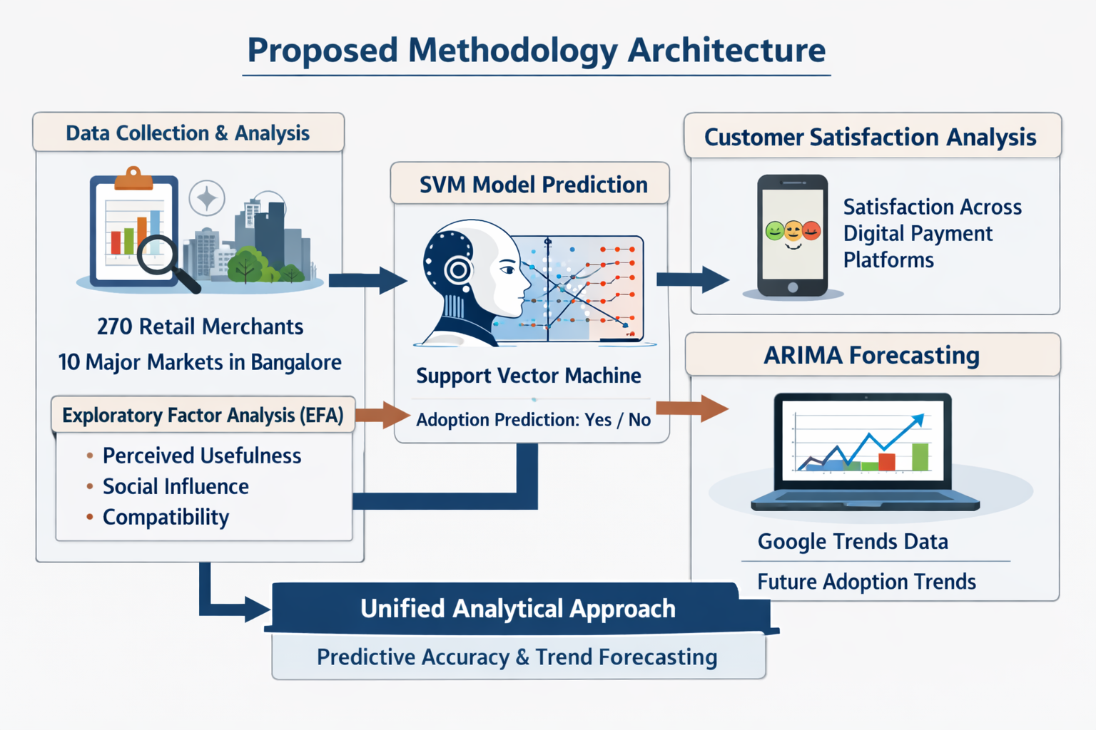
PROPOSED METHODOLOGY ARCHITECTURE
DATASET: 20 columns, 100 rows
EFA: Exploring important features
SVM: SVC classification Model
ARIMA: Future Prediction

Slide 12
MINIMUM SYSTEM REQUIREMENTS
SYSTEM REQUIREMENTS:
HARDWARE REQUIREMENTS:
PROCESSOR : Intel I3
RAM : 32GB
SPACE ON HARD DISK : minimum 1TB
SOFTWARE REQUIREMENTS:
PYTHON IDE : Anaconda Jupyter Notebook
BACK END : Jupyter Notebook
FRONT END : Django frame
PROGRAMMING LANGUAGE : Python

Slide 13
ANALYSIS & DESIGN

Slide 14
ANALYSIS
SYSTEM AND USER MODULES
Data Collection Module :
• Collect structured survey data from retail vendors including demographics, business type, transaction volume, and digital payment experience. • Standardize responses using normalization and encoding techniques to ensure consistency across users. • Validate survey inputs to prevent missing or incorrect entries. • Store data in a secure database for further analysis and ML processing. • Continuously update the dataset as more vendors participate in the survey. Feature Extraction Module :
• Extract significant behavioral and demographic features from survey data using Exploratory Factor Analysis . • Reduce dimensionality by grouping correlated variables into meaningful latent factors. • Transform raw survey responses into numerical representations suitable for machine learning. • Optimize selected features to improve prediction accuracy.

Slide 15
Model Training & Validation Module :
• Train Support Vector Machine (SVM) or similar ML models using cleaned and factor-extracted data. • Split the dataset into training, validation, and testing sets for performance measurement. • Apply preprocessing techniques such as scaling, normalization, and outlier removal. • Fine-tune hyperparameters (kernel type, C value, gamma,Probability) to maximize classification accuracy. • Validate the model using cross-validation and monitor accuracy, precision, recall, and F1-score. • Incorporate ARIMA time series forecasting to predict future digital payment adoption trends using external data like Google Trends.
Prediction & Classification Module :
• Classify each retail vendor’s likelihood of digital payment adoption using trained ML models. • Map predicted probability scores to adoption categories (High, Moderate, Low). • Display personalized adoption likelihood on the vendor dashboard. • Allow users to compare satisfaction levels across multiple digital payment platforms. • Ensure robustness by handling missing values, inconsistent responses, and noise in survey data.

Slide 16
System Integration & Real-Time Processing Module :
• Integrate ML predictions within the vendor’s personalized dashboard for instant feedback. • Enable secure user registration, authentication, and survey submission. • Provide real-time analytics visualizations such as bar charts, trends, and comparison metrics. • Allow administrators to manage user data and monitor participation directly through their portal. • Synchronize the Machine Learning module with admin analytics for seamless data flow. Performance Evaluation & Optimization Module :
• Evaluate ML models using accuracy, precision, recall, F1-score.
• Analyze prediction accuracy for different vendor categories and business types. • Reduce false positives/negatives by adjusting classification thresholds and retraining models. • Improve model performance using additional survey data and refined EFA-based features. • Compare different ML algorithms (SVM, Random Forest, Logistic Regression) for optimal efficiency. • Monitor ARIMA forecast accuracy by comparing predicted trends with real-world adoption patterns.

Slide 17
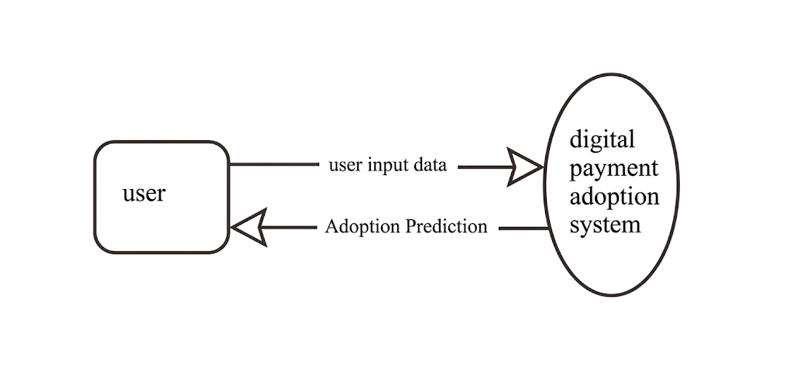
DESIGN
DATA FLOW DIAGRAM
A Data Flow Diagram shows how information enters and leaves the system, what changes the information and where information is stored.
LEVEL-0

Slide 18
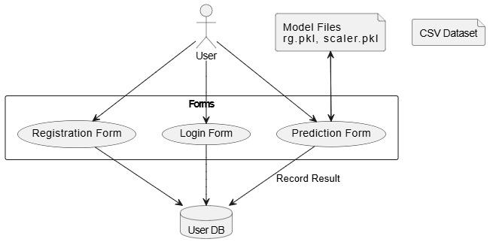
LEVEL-1

Slide 19
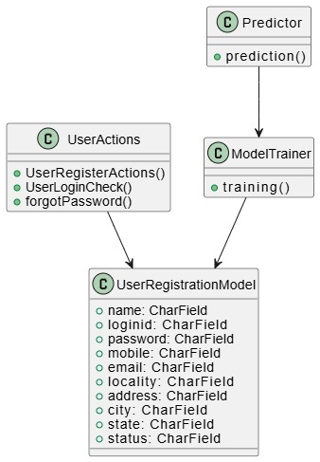
CLASS DIAGRAM
A class diagram in the Unified Modeling Language (UML) is a type of static structure diagram that describes the structure of a system by showing the system's classes, their attributes, operations (or methods), and the relationships among the classes.

Slide 20
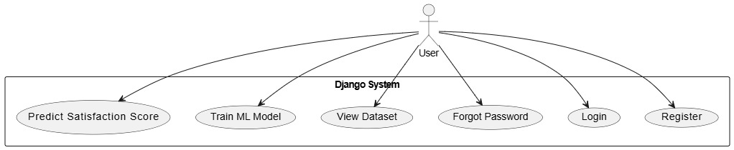
USE CASE DIAGRAM
A use case diagram in the Unified Modeling Language (UML) is a type of behavioral diagram. The main purpose of a use case diagram is to show what system functions are performed for which actor. Roles of the actors in the system can be depicted.

Slide 21
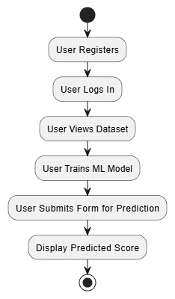
ACTIVITY DIAGRAM
Activity diagrams are graphical representations of workflows of stepwise activities and actions with support for choice, iteration and concurrency.

Slide 22
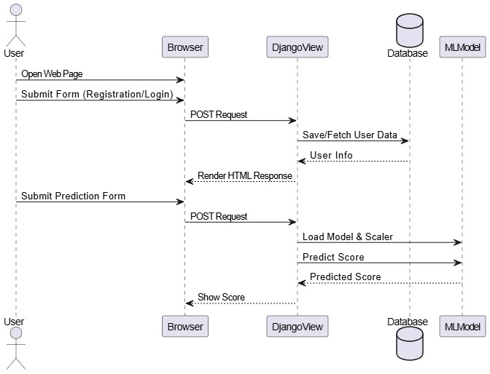
SEQUENCE DIAGRAM
A sequence diagram in Unified Modeling Language (UML) is a kind of interaction diagram that shows how processes operate with one another and in what order.

Slide 23
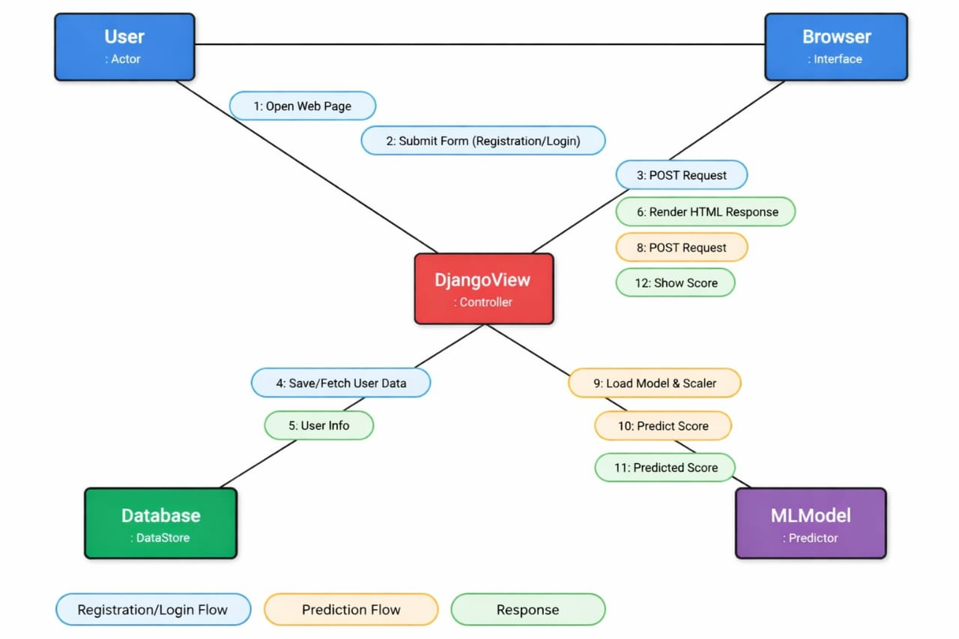
COLLABORATION DIAGRAM
A collaboration diagram emphasizes the relationships and connections between objects, highlighting how they interact with each other.
A sequence diagram shows "when" interactions happen, while a collaboration diagram shows "who” interacts with whom.

Slide 24
IMPLEMENTATION, TESTING & RESULTS

Slide 25
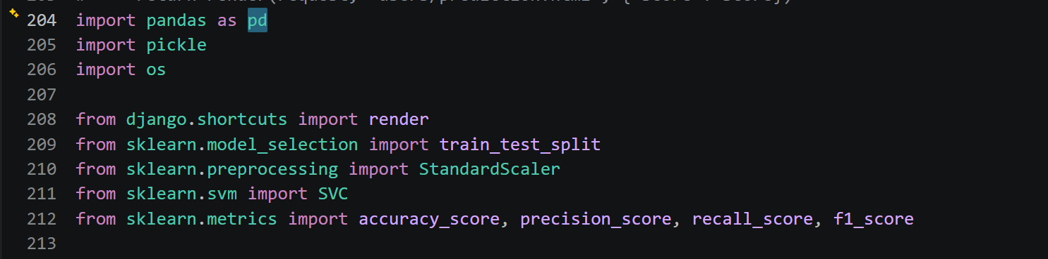
Importing Libraries and Relevant Methods

Slide 26
IMPLEMENTATION

Slide 27
FEATURE ANALYSIS (EXPLORATORY FACTOR ANALYSIS - EFA)
Exploratory Factor Analysis (EFA)
Exploratory Factor Analysis was conducted to identify the key factors influencing digital payment adoption among retail vendors.
Major Factors Identified:
🔹 Factor 1 – Compatibility
> Strongest influencing factor
> Indicates how well digital payments align with existing business practices
> Highest loading among variables
🔹 Factor 2 – Perceived Usefulness
> High factor loading (~0.987)
> Vendors adopt digital payments if they improve efficiency and performance
🔹 Factor 3 – Social Influence
> Influence of peers, customers, and competitors
> Strong behavioral impact on adoption decisions

Slide 28
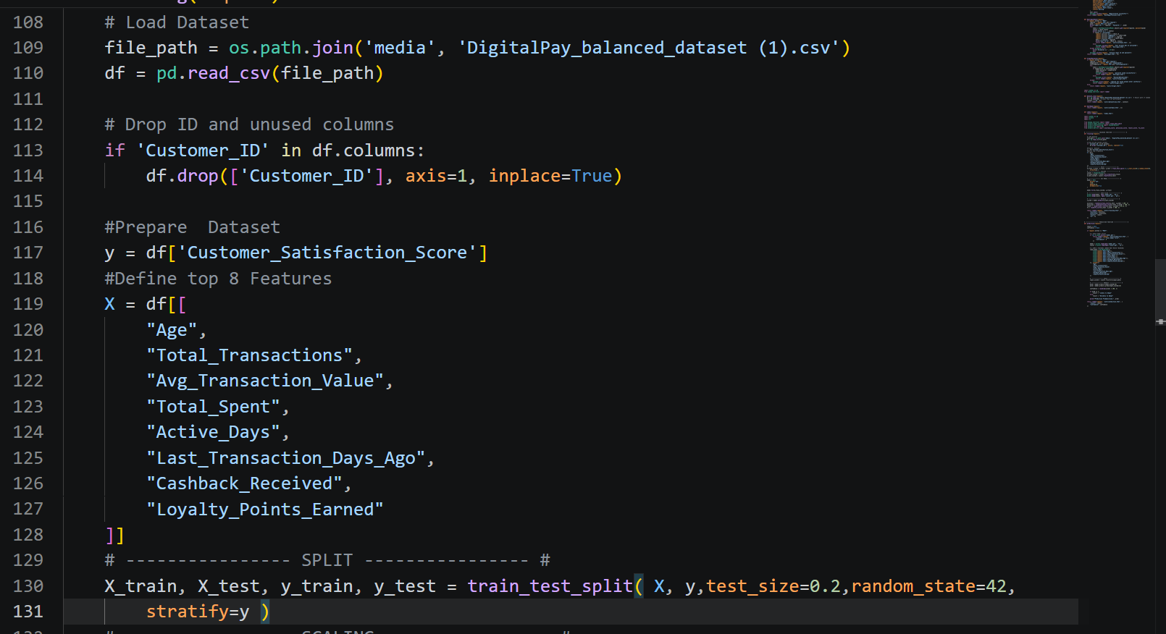
Data Preprocessing and Splitting

Slide 29
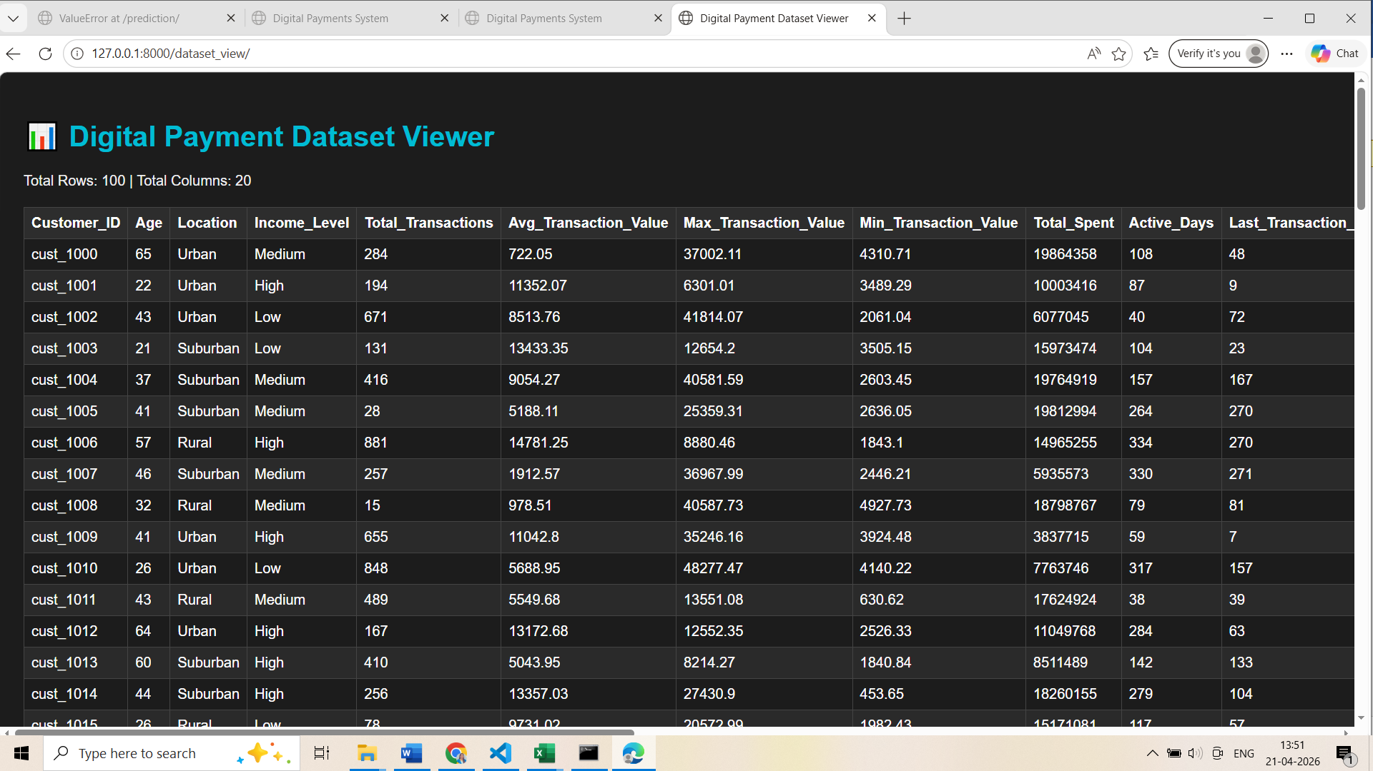
DATASET VIEW

Slide 30
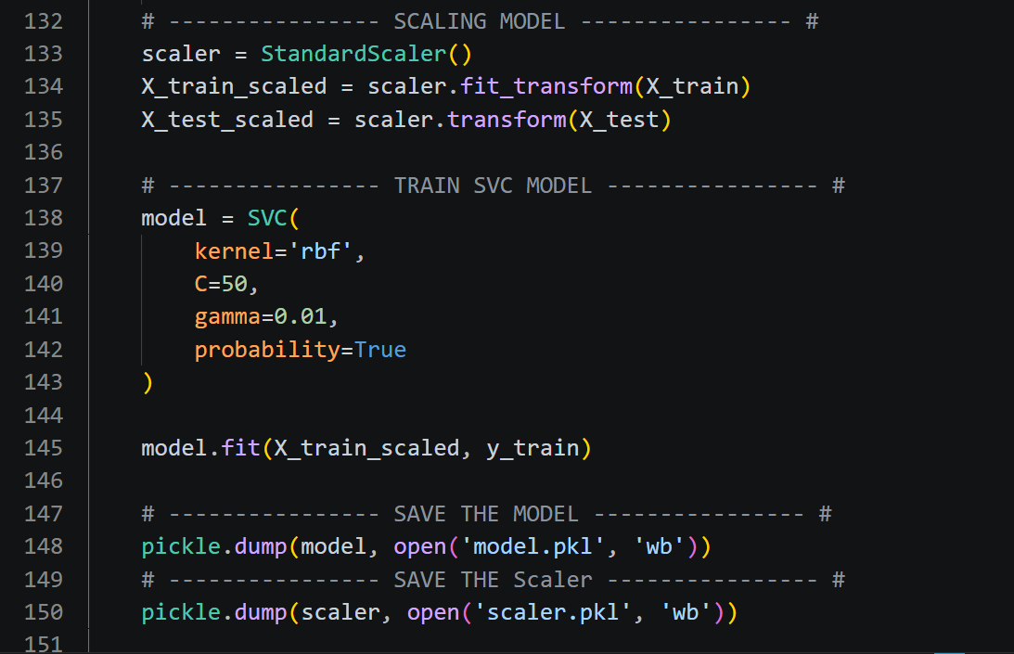
Training Model Architecture

Slide 31
TESTING

Slide 32
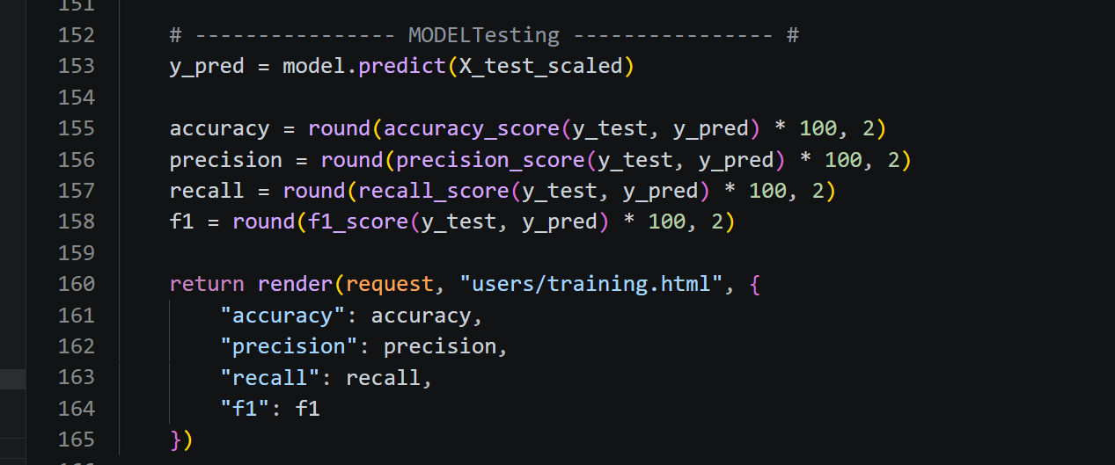
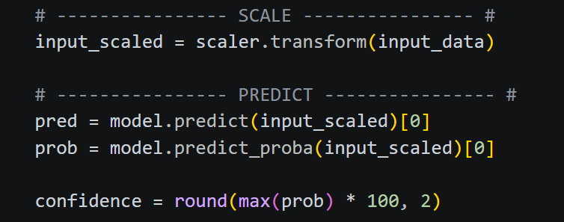
Model Testing

Slide 33
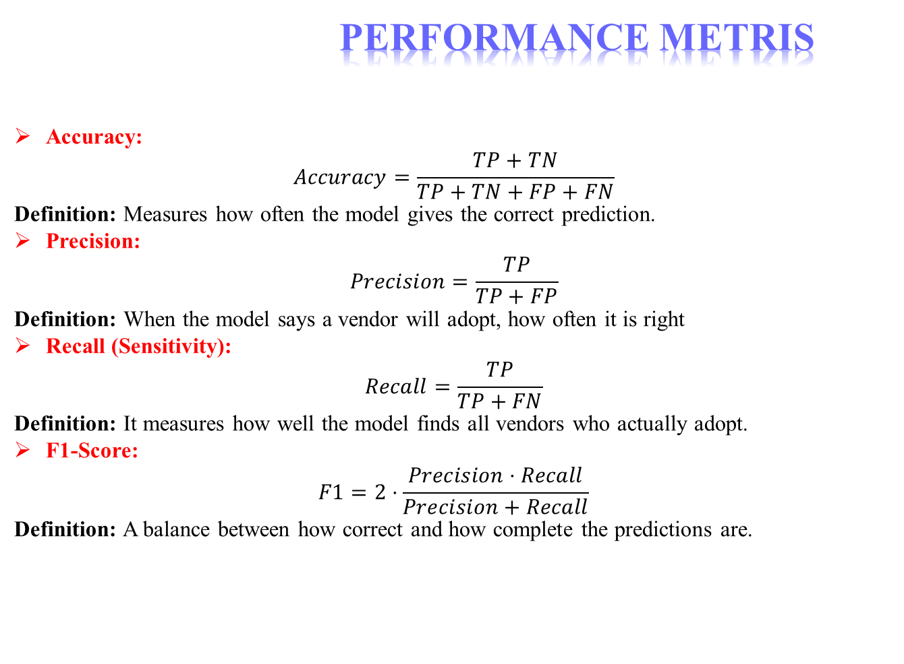
PERFORMANCE METRIS
Accuracy:
$$Accuracy=\frac{TP+TN}{TP+TN+FP+FN}$$ Definition: Measures how often the model gives the correct prediction.
Precision:
$$Precision=\frac{TP}{TP+FP}$$ Definition: When the model says a vendor will adopt, how often it is right
Recall (Sensitivity):
$$Recall=\frac{TP}{TP+FN}$$ Definition: It measures how well the model finds all vendors who actually adopt.
F1-Score:
$$F1=2⋅\frac{Precision⋅Recall}{Precision+Recall}$$ Definition: A balance between how correct and how complete the predictions are.

Slide 34
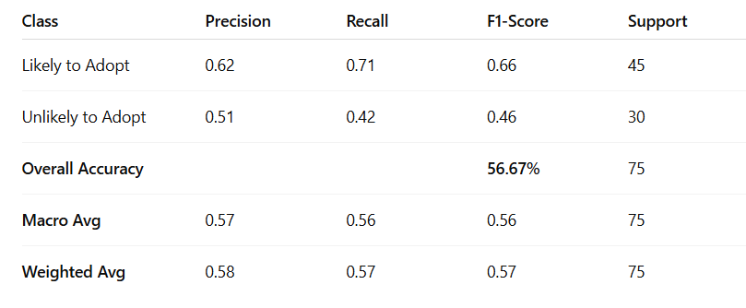
Classification Report

Slide 35
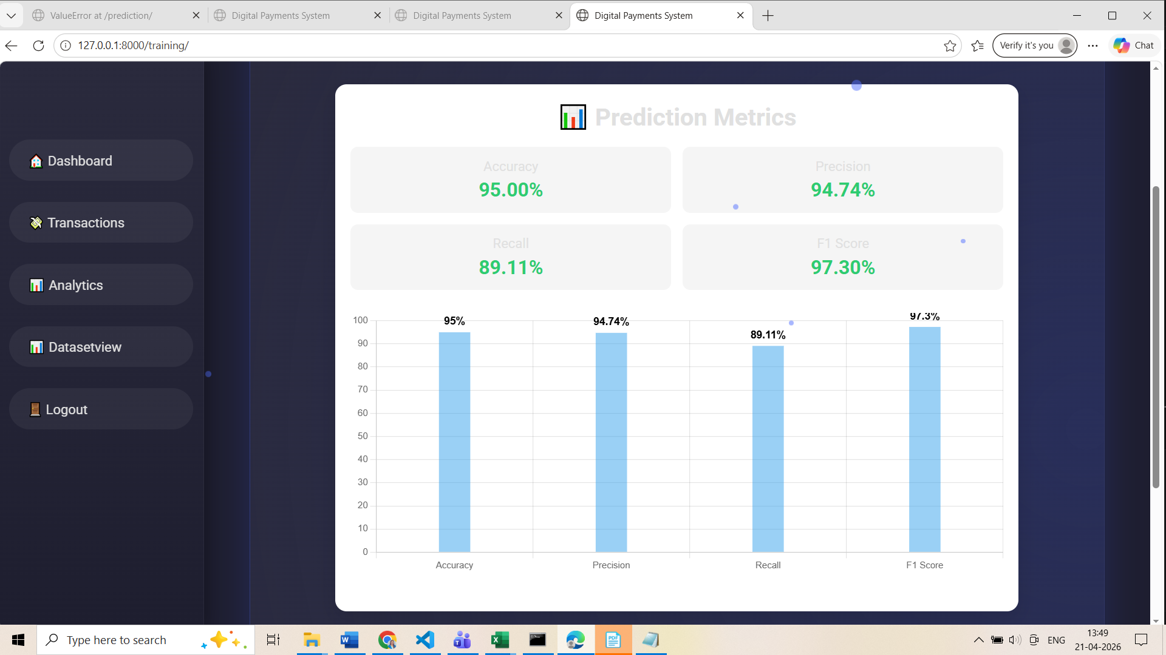
EVALUATION METRICS

Slide 36
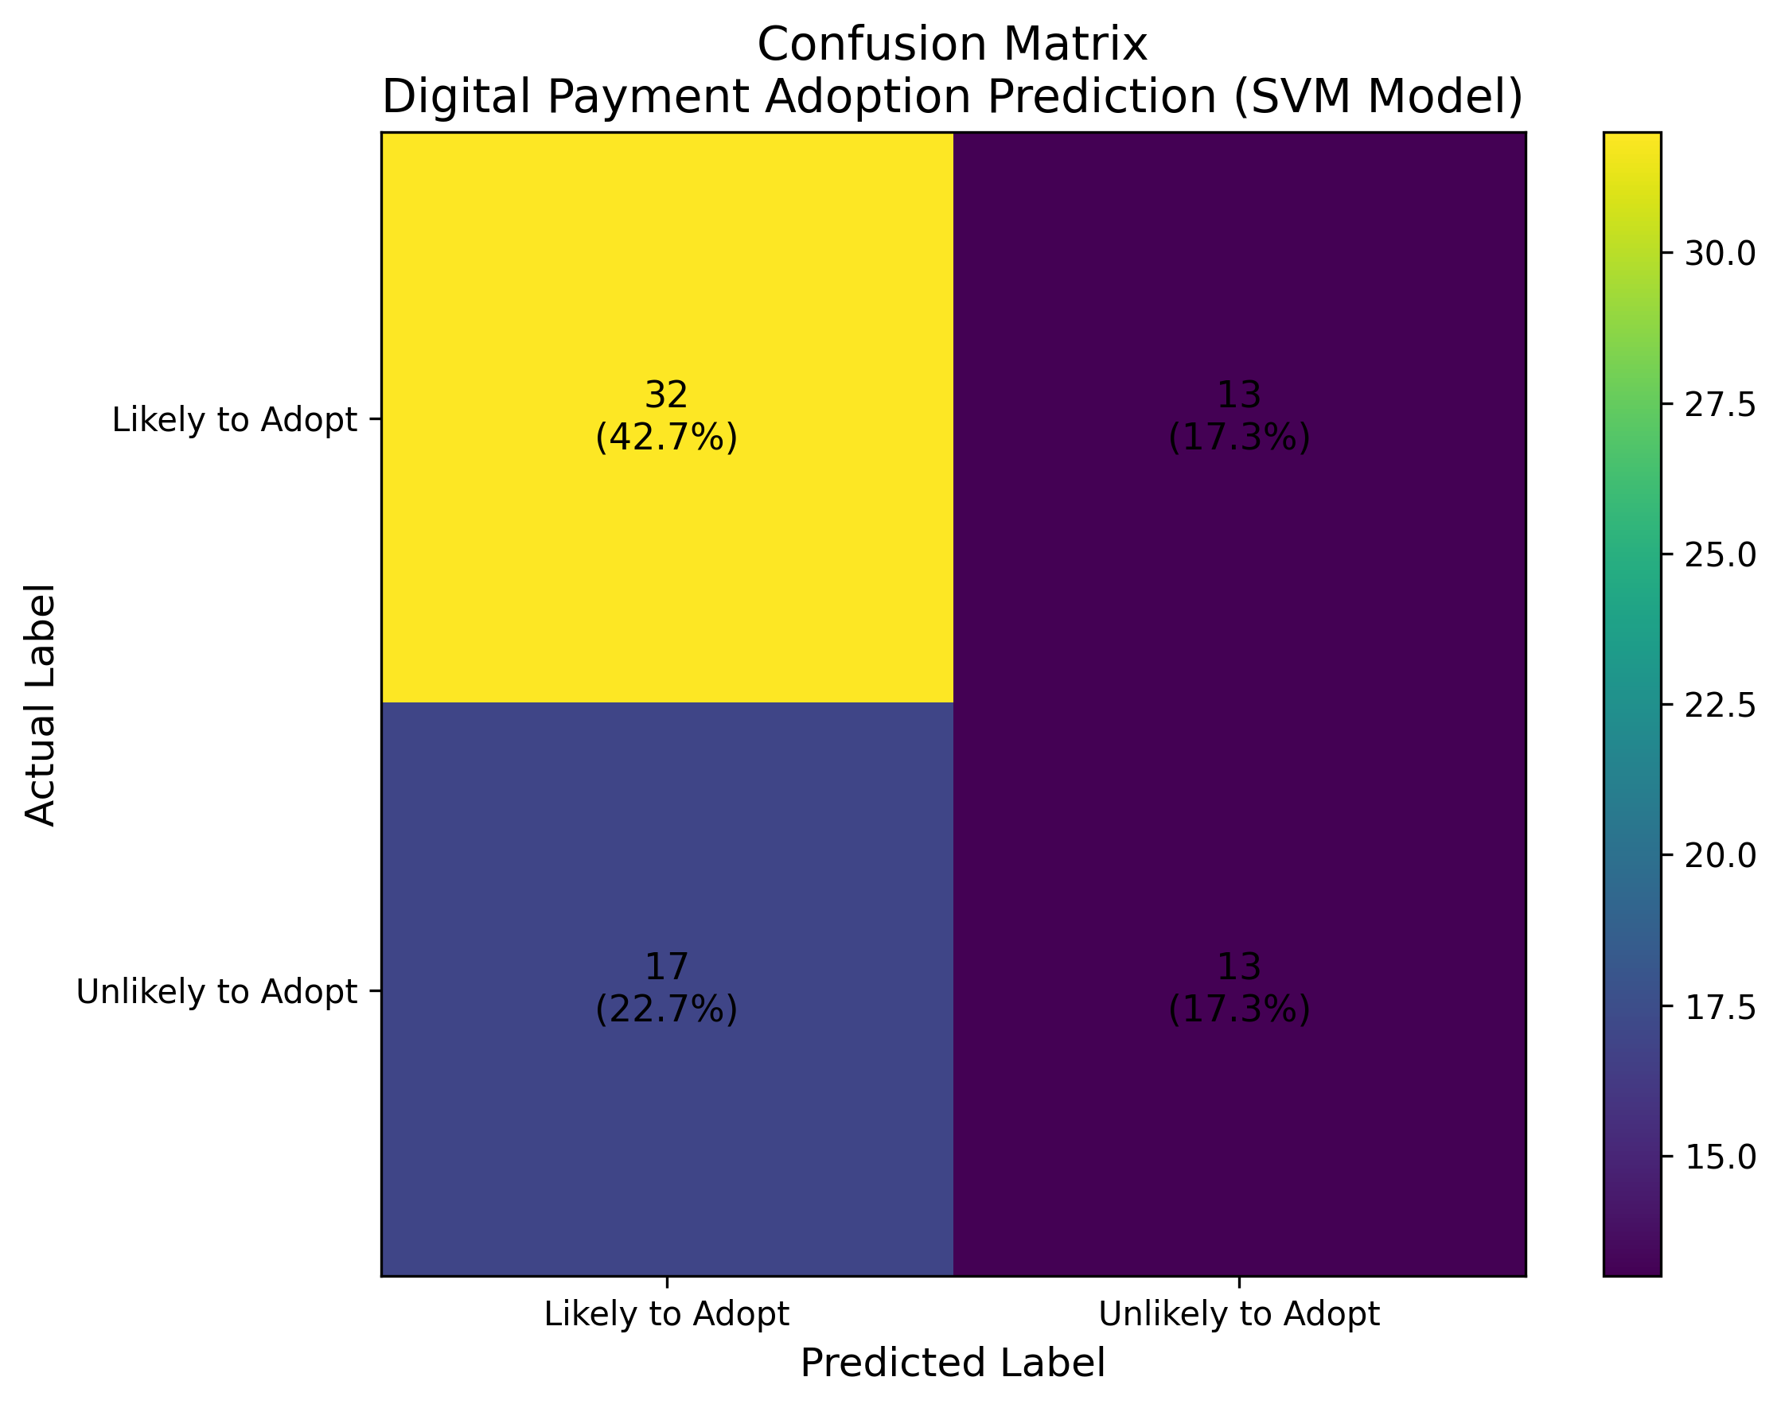
Visualizing Confusion matrix and Interpretation for Digital Payment Prediction

Slide 37
RESULTS

Slide 38
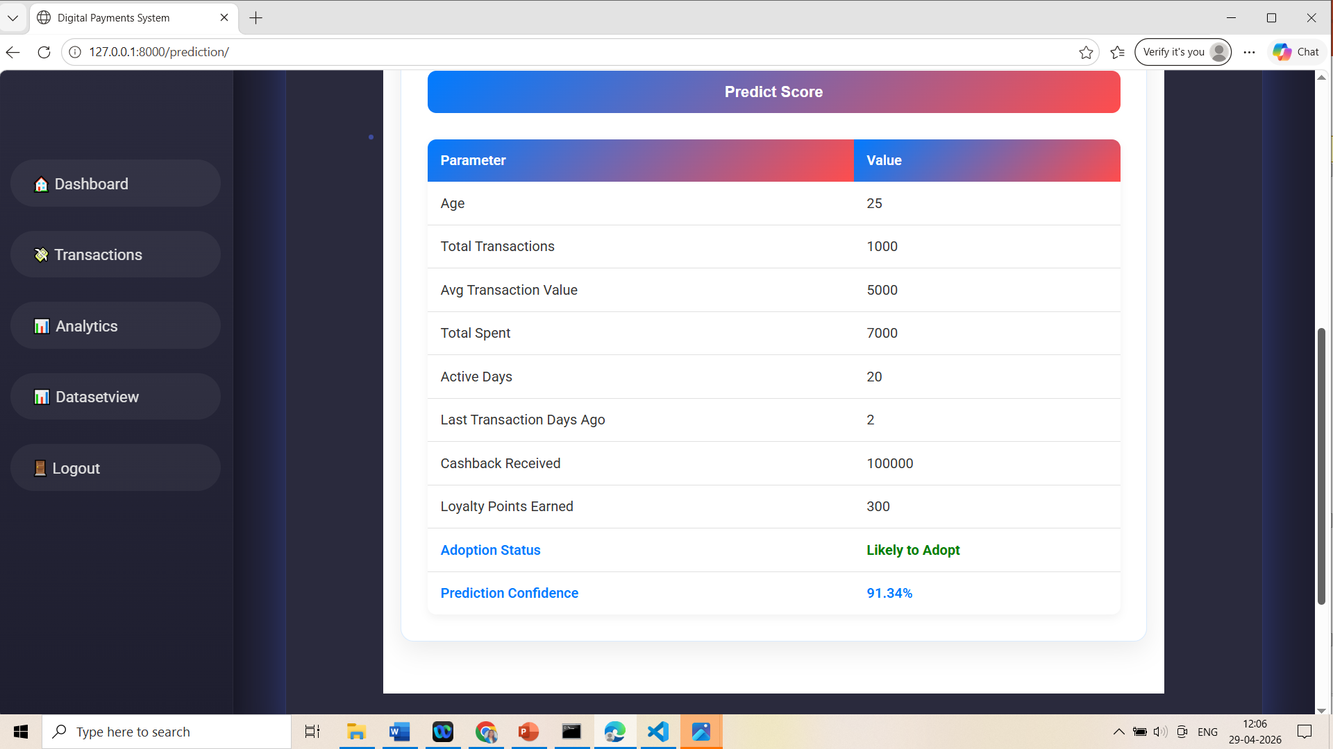
FINAL OUTPUT SCREEN

Slide 39
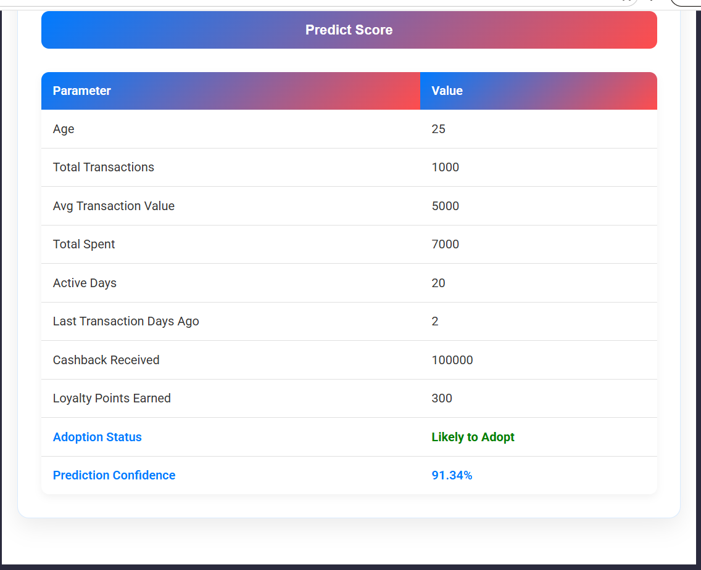
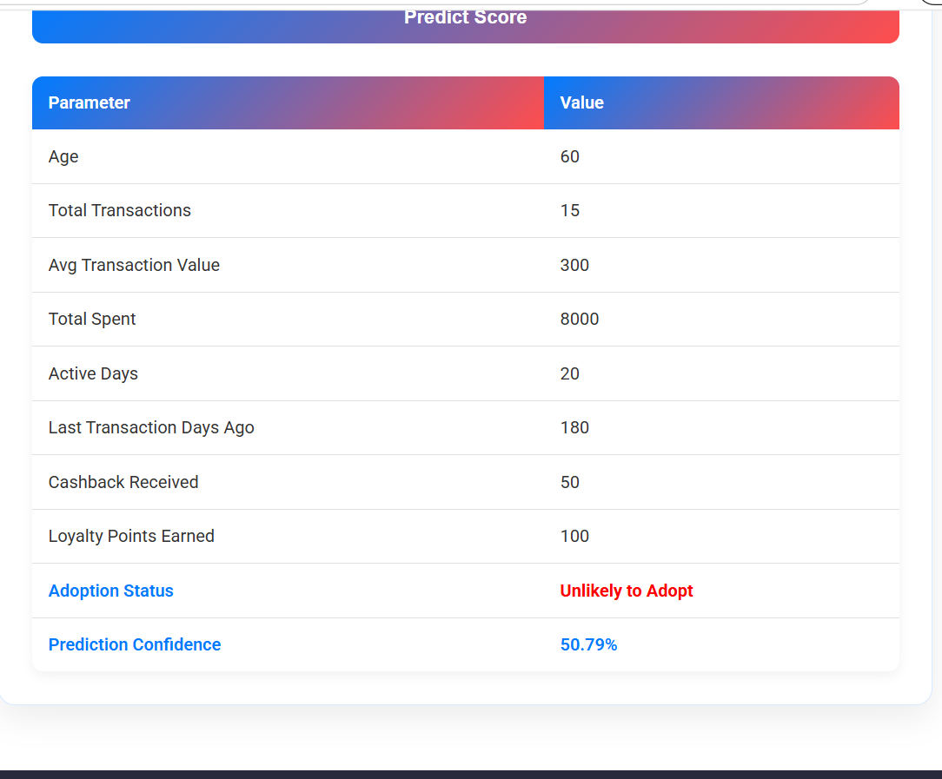
Sample Predictions

Slide 40
CONCLUSION
This research provides deep insights into what motivates retail vendors in Bangalore to adopt digital payment platforms. By combining traditional statistical analysis with the power of machine learning (specifically SVM), the study identified perceived usefulness, social influence, and compatibility as the leading drivers of adoption. The findings emphasize the necessity for digital platforms to align with existing business practices and peer expectations. Despite moderate accuracy, the SVM model offers promise, and satisfaction analysis shows room for improvement in platforms like GooglePay and AmazonPay. Through forecast modeling with ARIMA, the study shows a steady interest in digital payments, though future variabilities are possible. Moving forward, incorporating more advanced algorithms and qualitative methods can further refine understanding and help stakeholders drive broader digital adoption across the retail sector.

Slide 41
FUTURE SCOPE
To elevate the current model’s performance and broaden its applicability, several future enhancements are recommended. First, experimenting with advanced machine learning algorithms such as Random Forests, Gradient Boosting, or Neural Networks may uncover more nuanced insights and improve prediction accuracy. Secondly, ensemble methods that combine multiple models can offer improved robustness and reduce bias. Third, incorporating longitudinal data can help capture temporal trends in adoption behavior, offering a more realistic model of vendor behavior over time. Future research should also explore geographical comparisons to identify location-specific motivators or barriers. On the qualitative side, adding interviews, case studies, and focus groups would provide a richer understanding of vendor sentiment and behavior. Lastly, creating a real-time monitoring dashboard using streaming data could help policymakers and digital platform providers to dynamically adjust their strategies and improve vendor onboarding experiences.Use of Advanced ML Algorithms: Introduce models like Random Forest, XGBoost, or Deep Neural Networks for better accuracy and performance..

Slide 42
REFERENCES
J. Lara-Rubio, A. F. Villarejo-Ramos, and F. Liébana Cabanillas, “Explanatory and predictive model of the adoption of P2P payment systems,” Behav. Inf. Technol., vol. 40, no. 6, pp. 528–541, 2021.
S. Moghavvemi, T. X. Mei, S. W. Phoong, and S.Y. Phoong, “Drivers and barriers of mobile payment adoption: Malaysian merchants’ perspective,” J. Retail. Consum. Serv., vol. 59, no. November, 2021.
K. Khando, M. S. Islam, and S. Gao, “The Emerging Technologies of Digital Payments and Associated Challenges: A Systematic Literature Review,” Futur. Internet, vol. 15, no. 1, 2023.
R. Seethamraju and K. S. Diatha, “Adoption of digital payments by small retail stores,” ACIS 2018 - 29th Australas. Conf. Inf. Syst., pp. 1–11, 2018.
T. Ravikumar and N. Prakash, “Determinants of adoption of digital payment services among small fixed retail stores in Bangalore, India,” Int.J. Bus. Innov. Res., vol. 28, no. 3, pp. 319–346, 2022.

Slide 43
REFERENCES
S. Srivastava, “INDIA ’ S ORGANIZED RETAIL SECTOR :,” vol. 12, no. 6, pp. 892–898, 2024.
Rençber, “United theory of acceptance and use of technology,” Consum. Behav. Model., pp. 181– 192, 2020.
S. S. Guru, “AI - POWERED DIGITAL PAYMENTS : REVOLUTIONIZING TRAVEL , HOSPITALITY , AND RETAIL EXPERIENCES,” pp. 327–337, 2024.
M. Ashok Botta, “A study on the adoption of digital payment mechanism by small retail stores in Visakahapatanam city,” J. Posit. Sch. Psychol., vol. 2022, no. 10, pp. 61–66, 2022.
K. Kajol, R. Singh, and J. Paul, “Adoption of digital financial transactions: A review of literature and future research agenda,” Technol. Forecast. Soc. Change, vol. 184, no. January, p. 121991,2022.

Slide 44
Thank You
Any Questions

